Slide 1
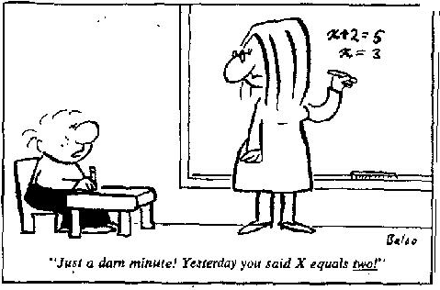
Section 11.1 Solving Basic Equations

Slide 2
What is Algebra?
A branch of mathematics that uses symbols/letters to represent a value [number] in an equation
Basic algebra can be used to find an unknown value in a real world problem
Ie: Jack went to the store and bought 4 apples. The total cost was $5, how much was each apple?
Ie: Two thirds of a class have brown hair. Fourteen people have brown hair. How many people are in the class?
The variable “x” represents the cost of each apple
“x” represents the number of people in the class

Slide 3
Solving Basic Equation [Level 1]
Solving an equation means finding a value for “x” so that both sides of an equation will be equal
The most basic equations require only multiplication or division to solve for an unknown value
Ex: If 4 apples is equal to $5, how much is each apple?
If we were to solve this algebraically, divide both sides of the equation by 4
$1
$1
$1
$1
The Fours cancel out on the left
$1
25¢
25¢
25¢
25¢
Split each side into four groups
So each apple is equal to $1.25

Slide 4
Ex: One third of all the coins in a bag are loonies. If there are 13 loonies in a bag, how many coins are there?
Let “x” be the number of coins in the bag
$1
$1
$1
$1
$1
$1
Since 1/3 of the coins are loonies and there are 13 loonies, write an equation
Multiply both sides by 3 to get rid of the denominator
There are 39 coins in the bag

Slide 5


Ex: Given the ruler and the boxes next to it, write an equation that describes the scenario & then find the length of “x”
The length of each “x” bar is equal to 2.5 units
The length of each “x” bar is equal to 1.75 units

Slide 6
Ex: Two thirds of a class have brown hair. Fourteen people have brown hair. How many people are in the class?
Let “x” represents the number of people in the class
-5+7=2
X²+3x+6=9
Multiply both sides of the equation by 3 to get rid of the denominator
There are 21 students in this class

Slide 7
Strategies for Solving Basic equations
When solving an equation, do the opposite of what “x” is doing
If “x” is multiplied to a number, divide both sides by that same number to isolate “x”
If “x” is divided by a number or multiplied with a fraction, then multiply both sides by that number {denominator} to isolate “x”

Slide 8
Practice: Solve for “x”
“Solving” means finding a value for “x” (Variable) so that both sides of the equation will be EQUAL!
To solve, do the opposite to what “x” is doing
Must always do the same thing to BOTH sides
“x” is multiplied to 2 and then add 8
“x” is multiplied to 3
“x” is multiplied to 4 and divided by 3
Opposite: Divide by 3
Opposite: Divide by 4
and multiply by 3
Opposite: Subtract 8
and then divide by 2

Slide 9
iv) A pie can be cut into 8 slices and 3 slices cost $7.99. How much would
one whole pie cost?

Slide 10
Homework:
P376 #5 – 18 (odd letters), 21, 23, 26, 28, 30

